Slide 1
AI & Digital Transformation
Group One

Slide 2
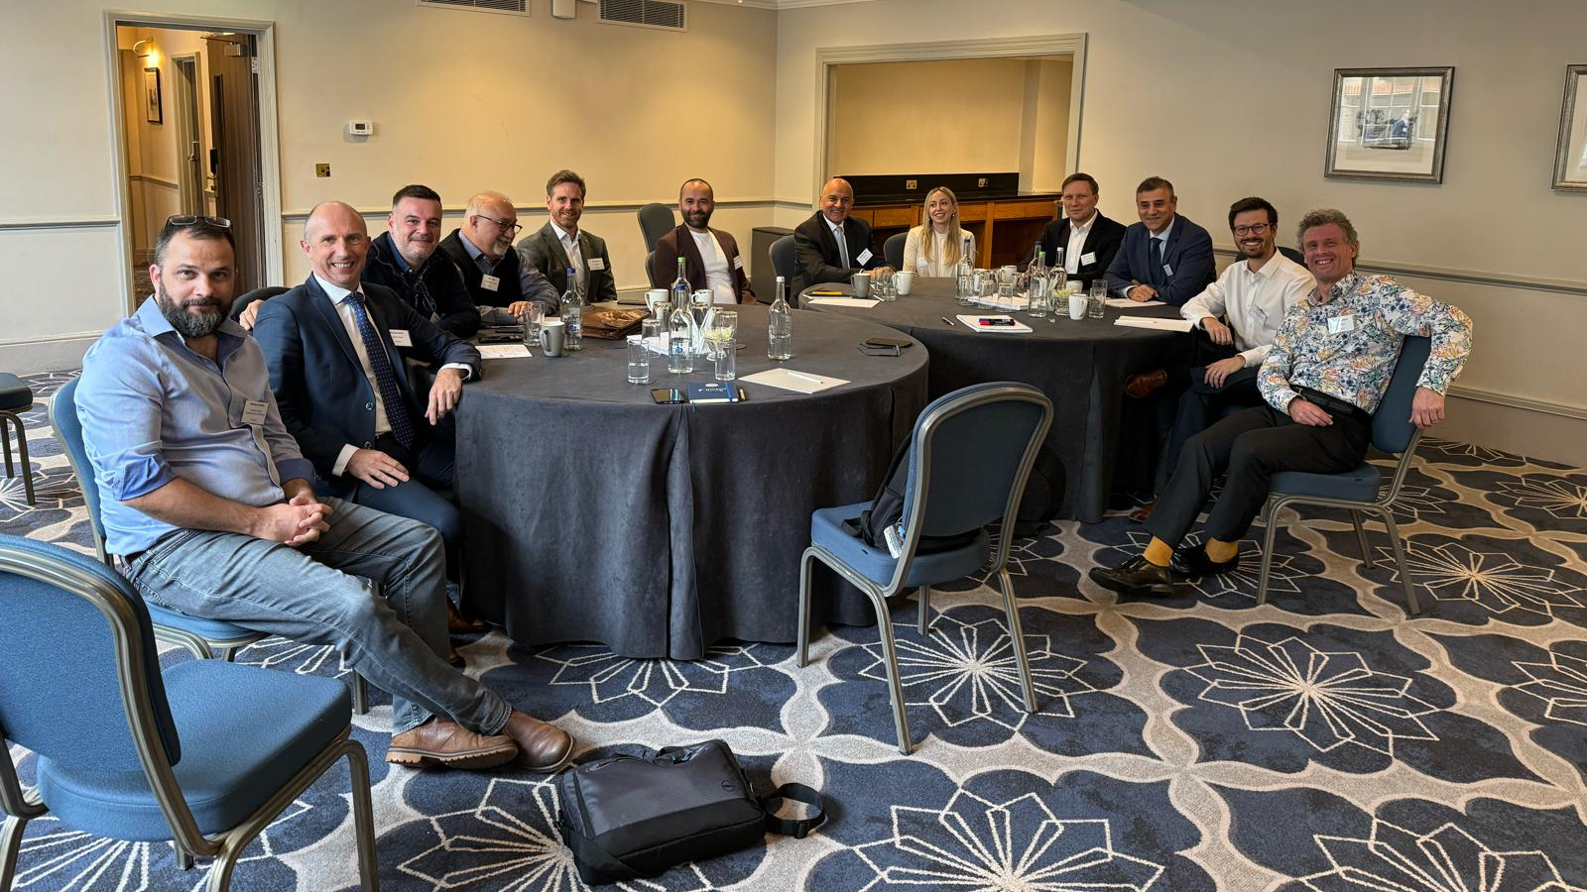
Team

Slide 3
AI & DT Group 1
Enablers
Big data
Anonymity
Cloud Computing
Barriers
Commercial / Project Risks
Hierarchical Ecosystem – Vertical & Horizontal

Slide 4
AI & DT Group 1
Automation
Application of Machine Learning
Data Engineering
Predictive Maintenance
Ethics
Fair usage
Nondiscriminatory (Skills transformation)
Social – Technical Barrier
What should we be teaching our younger workforce?
Digitalization
Intelligent Q & A
Non-obvious insights
Planning/Cost/ Schedule
We use AI to assist in planning, scheduling & controlling costs

Slide 5
AI & DT Group 1
IoT
Intelligent decision making
Risk
AR/MR
AI for additional contextual information
Pre-emptive Mitigation
Drones
Image Capture
Process

Slide 6
Hazard Spotting
RISK
Discrimination in Decision Making
Predictive Safety Assessments
Lessons Learned (non-obvious insights)
Ergonomic inputs
Predict safe / comfortable liability
Personal Monitoring
Pre-emptive mitigation
Bid Risk
“Cleaning” the incoming data
Cross language and Discipline Decoding
Gap Analysis

Slide 7
Information Workflows, Digital responses (on field)
Digitalization
Cloud Computing
Collaboration/communications
Knowledge sharing efficiency
Schedule
Prediction
Weather flooding
More accurate optionee
Apply AI in planning
Check new resources / data vs old data
Adapt live program based on local environmental data
Auto reporting of commercial impact
Trends – Share anonymous IPLOCA Big Data
Brand new processes, people think the information is correct
Social Impact

Slide 8
Information Workflows, Digital responses (on field)
Control Systems
Data Engineering
Cleaning
Featuring Collection
Formatting
Cost Control
Estimating – checking against past/old data
Resource Optimization
Intelligent Deconfliction to assist in planning, scheduling & cost control

Slide 9
AI Transformation
Automation
Predictive Maintenance
Design Templating
Pattern Finding reliable data feedback
Fully automatic welding
Auto adjustments
Drones
Image Capture Process
Quality Trust Emergency Response
Fast / safer AI Copilot to keep drone compliant
Material Delivery

Slide 10
AI & DT
AR / MR
Image Overlay
Interaction
Overlay of metadata (AI for additional contextual info)
Machine Learning
Ethics
Personal Redundancy Insight
Data Cleaning
Checking Duplicates

Slide 11
IoT
Quality Data Collection – Be careful with Data Integrity
Sensors
Fuel Consumption predictions
Material Use
Progress – Construction Activities
Managing complete energy systems
We use AI in IoT to produce intelligent decision making

Slide 12
Questions
Thank you

