Slide 1
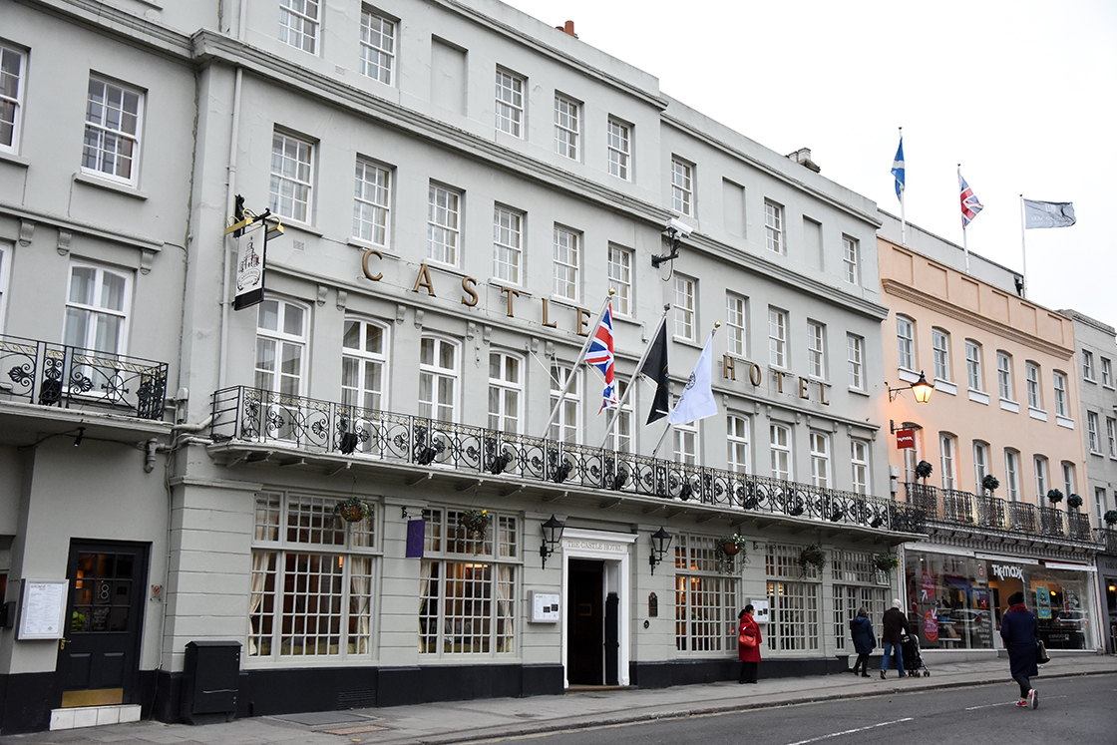
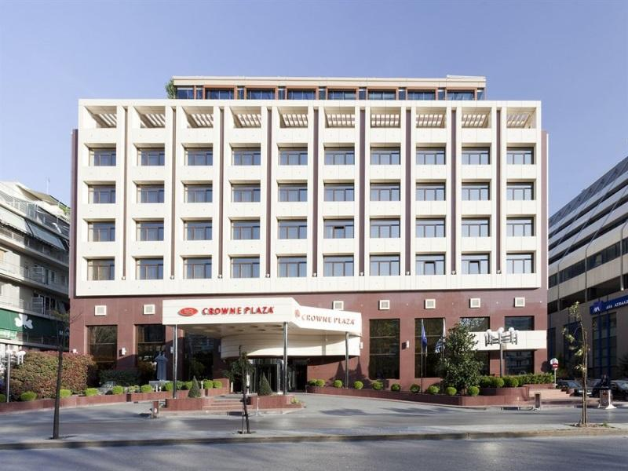
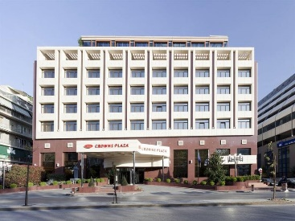
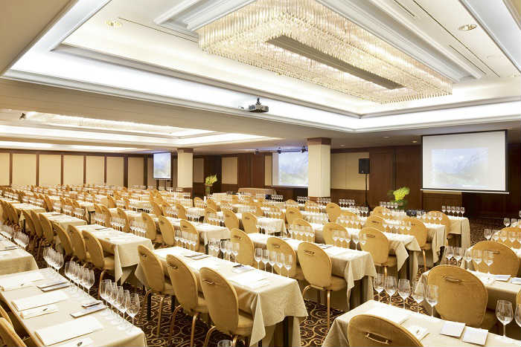
INNOVATION COMMITTEE – Novel Construction Initiative Spring Session 2024 – Windsor (United Kingdom)
www.iploca.com

Slide 2
Novel Construction Initiative Session – Spring 2024
Group 3
Standards & Compliance Regulatory – Materials, Codes

Slide 3
Novel Construction Initiative Session – Spring 2024
Room = Blenheim
Lead = Virginie Colaiuta
Iploca Board representative = Bruno Pomaré
Group Helper = Sandra Calderon

Slide 4
Novel Construction Initiative Session – Spring 2024
Definition of Net Zero for pipeline industry
Harmonisation of Standards (technical + regulatory)
Collaboration with Universities/organisations
IPLOCA Academy (training programme + workshops + mentoring + standard + Webinars)
Development of common research projects
Recycling standards for pipeline projects and re-use of materials
Repurposing of pipeline projects

Slide 5
Novel Construction Initiative Session – Spring 2024
Definition of Net Zero for pipeline industry
Supply chain + materials + project life cycle.
How energy transition impact?

Slide 6
Novel Construction Initiative Session – Spring 2024
Harmonisation of Standards (technical + regulatory)
Encourage international treaties.
Recommendation of IPLOCA in common base technical template.
Definition of basic values and criteria inspiring standards for construction and operation of pipelines

Slide 7
Novel Construction Initiative Session – Spring 2024
Collaboration with Universities/organisations
Research projects with students.
Organisation of other industries (Energy transition and related aspects).
Associations for lobbying purposes and development of regulatory specifications.
Definition of grading system for compliance with Net Zero / carbon footprint / omission.
Data bases of regulatory requirements country by country for specific technical issues.
Research for new materials/analysis of geopolitical.

Slide 8
Novel Construction Initiative Session – Spring 2024
IPLOCA Academy (training programme + workshops + mentoring + standard + Webinars)

Slide 9
Novel Construction Initiative Session – Spring 2024
Development of common research projects
IPLOCA recommendations for technical efficiency in special operations (tie-in, crossings, ….)
Study step by step of tie-in phase for development of technical standards and research.
Collaboration between members on common subjects.

Slide 10
Novel Construction Initiative Session – Spring 2024
Recycling standards for pipeline projects and re-use of materials

Slide 11
Novel Construction Initiative Session – Spring 2024
Repurposing of pipeline projects

Slide 12
Novel Construction Initiative Session – Spring 2024
Thank you
Group 3!

