Slide 1
Energy Transition
A difficult theme, in isolation against all the other group themes associated with the Energy Transition
However, we focused on “what is Energy Transition” and keeping away from the detail, support and specifications, that other groups would be focused on .
We quickly came up with 11 headings that where key to the energy transition opportunities
We then Ranked the 11 headings by importance to the “membership” and the time to populated and report on the theme

Slide 2
Public perception
Greener pipeline / sustainable pipelines
Support the ET
Positive impact
Global warming
Educate public
Do we become an official commentator / Voice
R&D
Sharing best practice
Gathering the R&D
IPLOCA take the lead in ????
Types of energy / vectors and Usages of Alternative energy (not pipelines)
“define Energy transition “
Solar / Hydro electric
H2 /CCS/ CCUS / Blending / de – blending
LNG / Ammonia
Oil / fuel / Waste heat. / Flaring
HVO fuel/ bio fuel
Aviation SAF
Nuclear
Existing Networks
Repurposing
Decentralisation / decarbonisation
Local energy plants Network / district heating
Nuclear / Small Medium reactors
Funding locally
Government support /policies
Gather information.
Power networks
Cable
Environmental impact
CSR
IPLOCA support and statistics + Road Map
Capture report and information.
Support companies with ET committees and agenda + networking.
Greens certificate/ measurement
Procurement “How green” “how local” Carbon reporting
Enviro impact / COST
Define what’s great.
Supplychain analyse
Energy Storage
Batteries
Hydrogen storage
hydroelectric pump

Slide 3
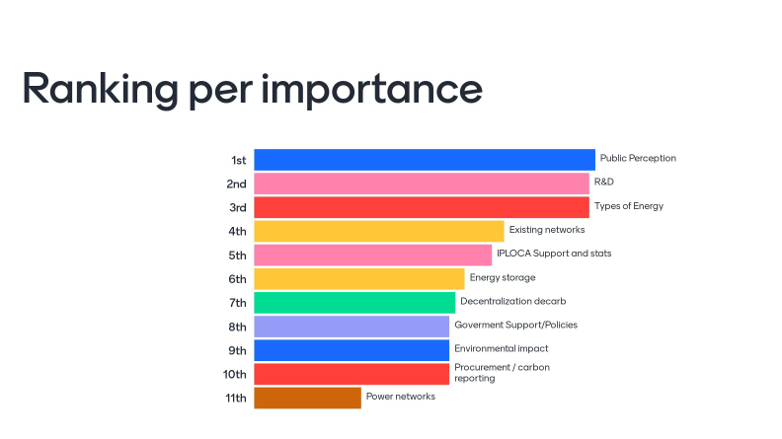

Slide 4
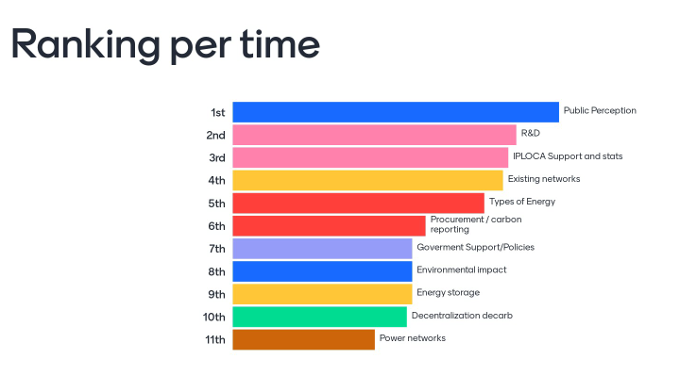

Slide 5
The voting from the group, resulted in the top 5 themes to be taken forward, after considering importance and time

Slide 6
Types of energy / vectors and Usages of Alternative energy (not pipelines)
“define Energy transition “
Solar / Hydro electric
H2 /CCS/ CCUS / Blending / de – blending
LNG / Ammonia
Oil / fuel / Waste heat. / Flaring
HVO fuel/ bio fuel
Aviation SAF
Nuclear
Public perception
Greener pipeline / sustainable pipelines
Support the ET
Positive impact
Global warming
Educate public
Do we become an official commentator / Voice
R&D
Sharing best practice
Gathering the R&D
IPLOCA support and statistics + Road Map
Capture report and information.
Support companies with ET committees and agenda + networking.
Greens certificate/ measurement
Existing Networks
Repurposing
Nuclear / Small Medium reactors
Funding locally

Slide 7
Key considerations
High Relance on third party information outside IPLOCA know-how
Liability Risk because of third party information ?
Public Perception is major shift for IPLOCA/ Presence and endorsement
We should embrace Social media with the New initiative, adopting new ways of communication i.e social media, membership. Modern way of sharing news – Animated clips LinkedIn !!
Website with open content information links, and membership only area for the specific details
High level promotion of the new initiative for all of the groups
Approach/inform corresponding members of the new initiative to get them on board and also write out to “other corresponding Non-member” to advise them

