Slide 1

IPLOCA ENV AWARDS
Using Containers as Noise Barriers

Slide 2
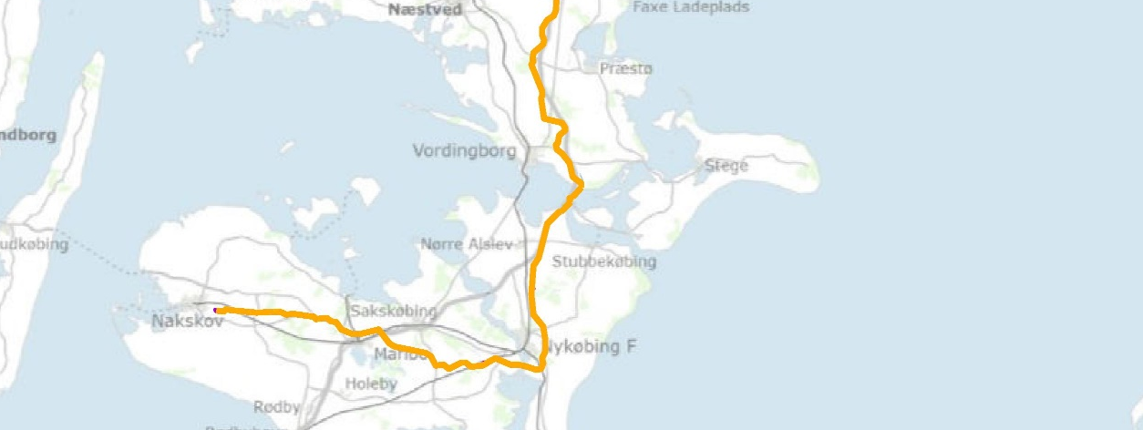
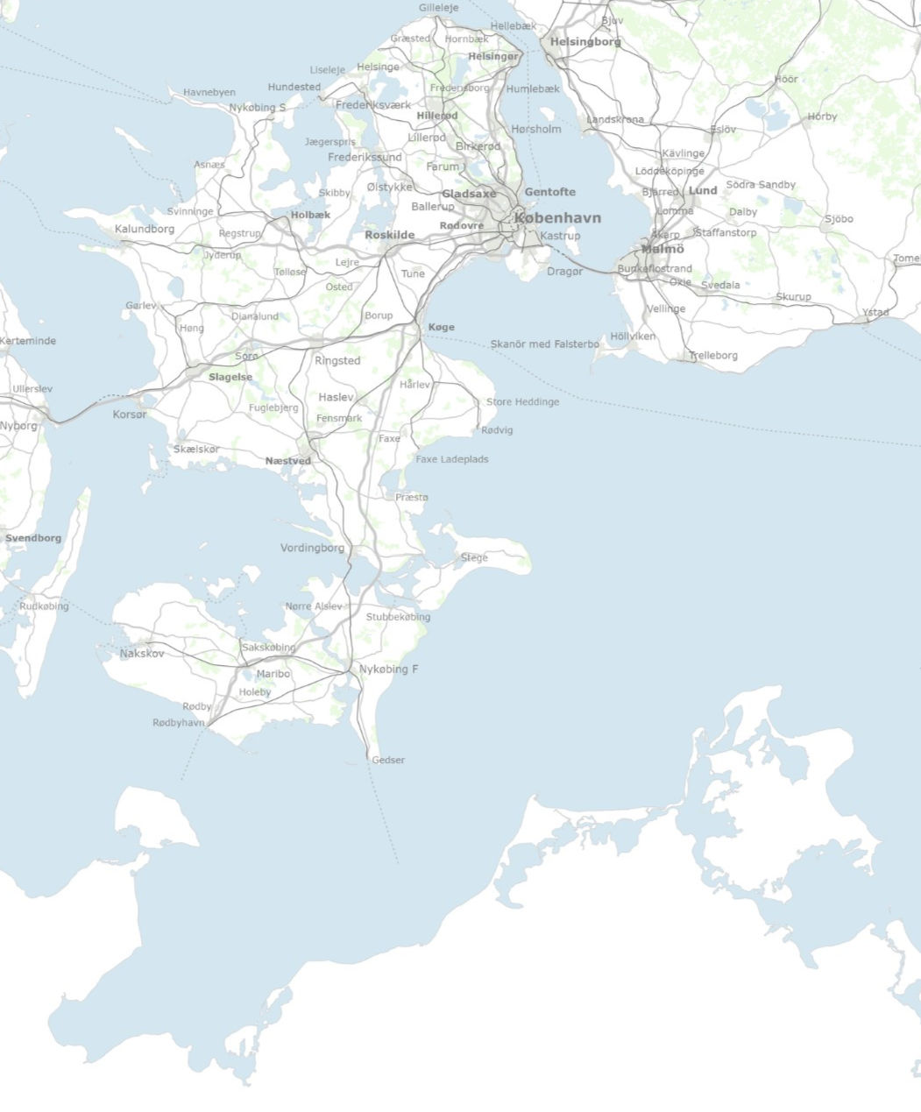
INTRODUCTION TO THE PROJECT
The Green Gas Lolland Falster project is about constructing a gas grid in Denmark on Lolland-Falster with gas supply from Sjælland, starting from the tie-in at Baltic Pipe's compressor station in Everdrup. The gas network on Lolland-Falster supply industries, including the sugar factories in Nykøbing Falster and Nakskov, with natural gas as well as collecting biogas. In total the project includes 115 km of pipeline.
HDD
HDD
HDD

Slide 3
What issue or problem is our solution trying to solve?
Directional drilling activities are associated with high levels of noise, which can have a negative impact on surrounding communities, local wildlife and residents' quality of life. Reducing this noise nuisance is a major challenge for our company and the industry as a whole.

Slide 4
What solution do we propose?
We have used an innovative solution by using containers as noise barriers around our directional drilling sites. These containers, generally used for transporting goods, have been transformed into effective acoustic barriers. They are strategically positioned around our drilling sites to reduce the spread of noise to residential areas and sensitive environments.
Tested & approved!

Slide 5
Impacts
Our solution helps to reduce the demand for new building materials. This conserves natural resources while reducing waste and promoting environmental sustainability.
Minimiser les perturbations pour la faune locale et les écosystèmes sensibles. Cela peut aider à préserver la biodiversité et à maintenir l'équilibre écologique dans les zones environnantes.

Slide 6
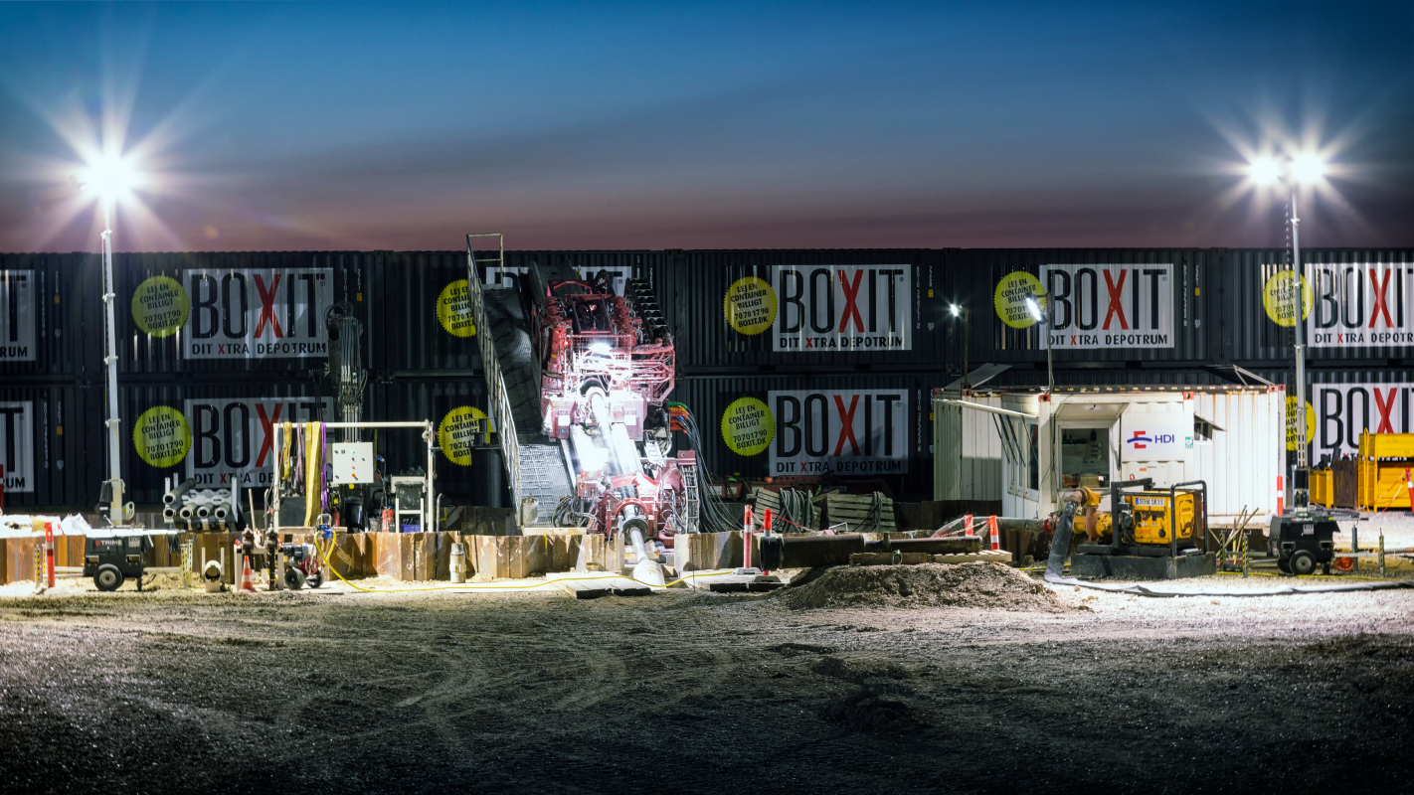

Slide 7
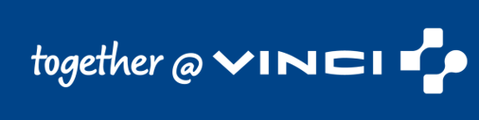
THANKS FOR YOUR ATTENTION!

